Slide 1
Safety Helmet Detection Using Deep Learning: Implementation and Comparative Study Using YOLOv5, YOLOv6, and YOLOv7

Slide 2
Agenda
Abstract
Introduction
Background about the data
YOLO models architecture
Model Training & Evaluation
Results & Discussion
Conclusion
Future work

Slide 3
Abstract
Safety on construction sites relies heavily on employees wearing personal protective equipment (PPE), especially hard hats.
Image processing and deep learning (DL) have become popular for safety helmet surveillance due to their ability to accurately detect objects from raw data.
The paper aims to evaluate and study the performance of different DL algorithms
The main objective of this paper is to implement YOLOv5, YOLOv6, and YOLOv7 models and to compare the performances of these three YOLO models for safety helmet detection.

Slide 4
INTRODUCTION
Manually monitoring safety helmets usage in large workplaces is difficult and prone to mistakes.
Deep learning, an AI area, excels at object detection tasks and can automatically learn and extract features from raw data.
Object detection is a computer vision task that involves identifying and localizing multiple objects within an image or a video.
It aims to determine the presence of specific object classes and draw bounding boxes around them to precisely indicate their locations.

Slide 5
ABOUT THE DATA
The Kaggle hard hat dataset is used for training DL models and contains 5,000 images in PASCAL VOC format with bounding box annotations.
The dataset includes images of the following class:
Helmet
Person
Head
The Mendeley dataset is an enhanced version of the Kaggle dataset, with seven classes including face, helmet, person, head, head with helmet, person with helmet, and person no helmet
Edited Mendeley dataset is created by eliminating some classes from Mendeley dataset and includes classes like head with helmet , head with no helmet , person with helmet and person with no helmet

Slide 6

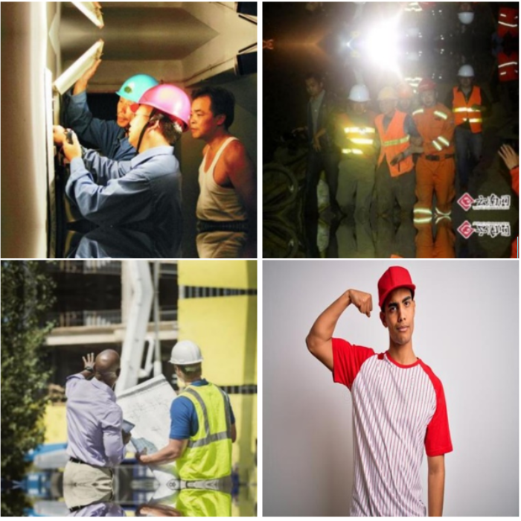
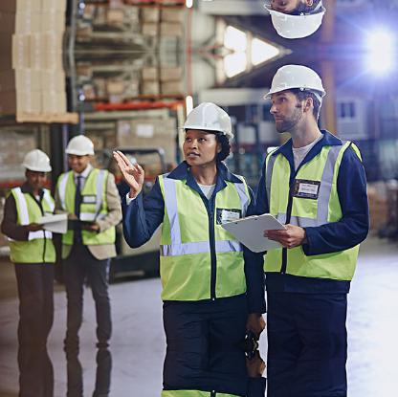
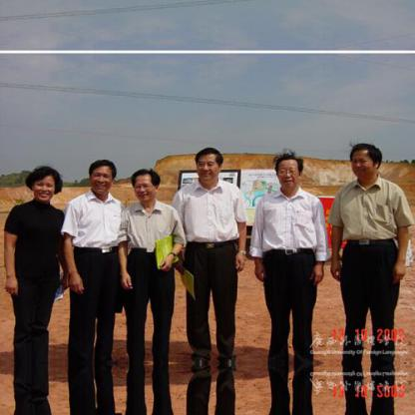
Sample images

Slide 7
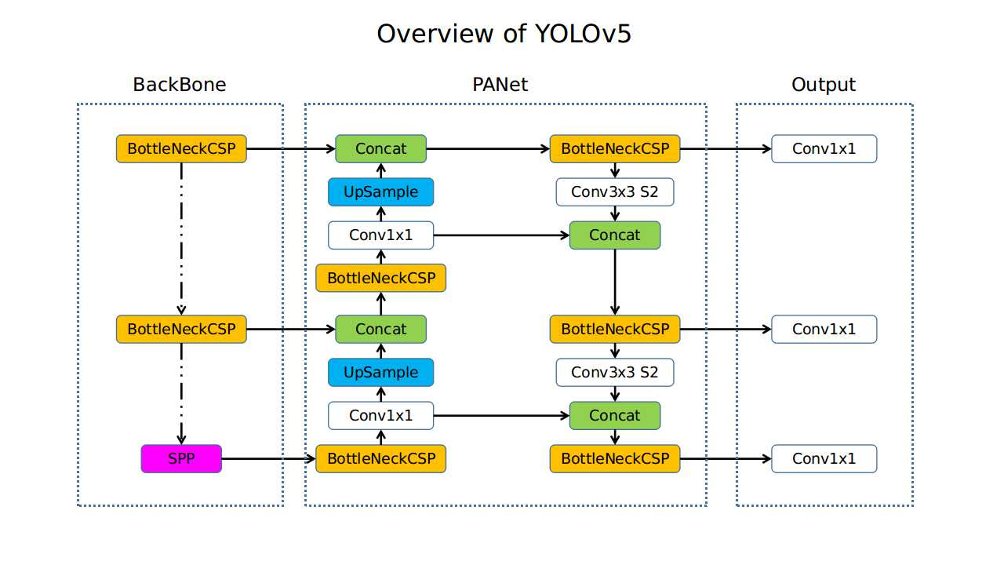
YOLOv5 MODEL ARCHITECTURE
YOLOv5 is an efficient object detection model with a CSPDarknet53 backbone and a YOLO head.
This backbone is responsible for feature extraction from the input images.
The neck of YOLOv5 uses Path Aggregation Network (PANet) to efficiently transfer information within the model.
The head of the YOLOv5 model is made of the Yolo layer, which enables multi-scale object prediction by generating feature maps of three different sizes.

Slide 8
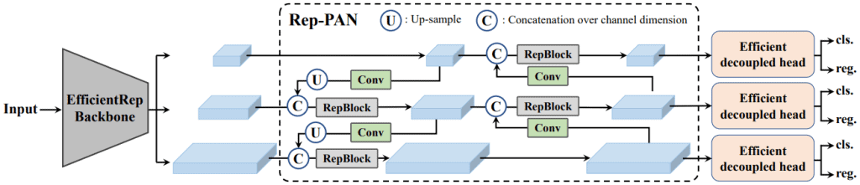
YOLOv6 MODEL ARCHITECTURE
YOLOv6 is a single-stage object detection framework dedicated to industrial applications, with hardware-friendly efficient design and high performance.
Unlike the previous YOLO architectures, use anchor-based methods for object detection, YOLOv6 opts for the anchor-free method. This makes YOLOv6 51% faster compared to most anchor-based object detectors.
YOLOv6 uses the EfficientRep backbone consisting of RepBlock, RepConv, and CSPStackRep blocks.

Slide 9
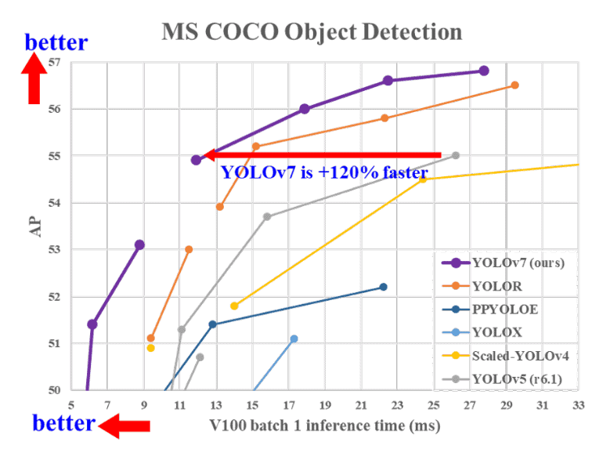
YOLOv7 ARCHITECTURE
Architectural Reforms
E-ELAN (Extended Efficient Layer Aggregation Network)
Model Scaling for Concatenation-based Models
Trainable BoF (Bag of Freebies)
Planned re-parameterized convolution
Coarse for auxiliary and Fine for lead loss
The E-ELAN is the computational block in the YOLOv7 backbone

Slide 10
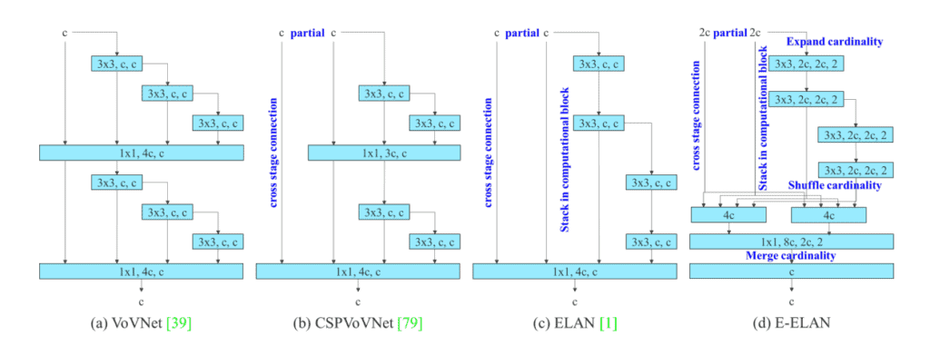
YOLOv7 MODEL ARCHITECTURE

Slide 11
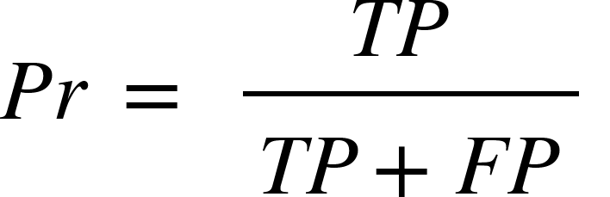
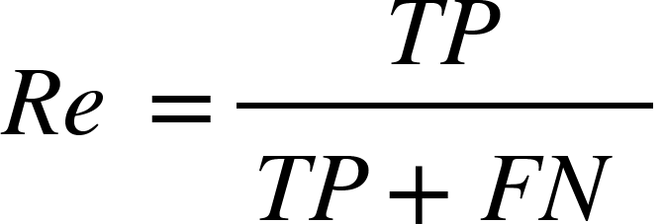
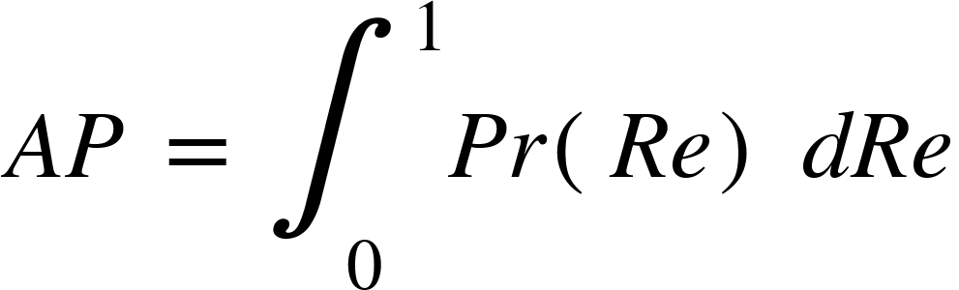
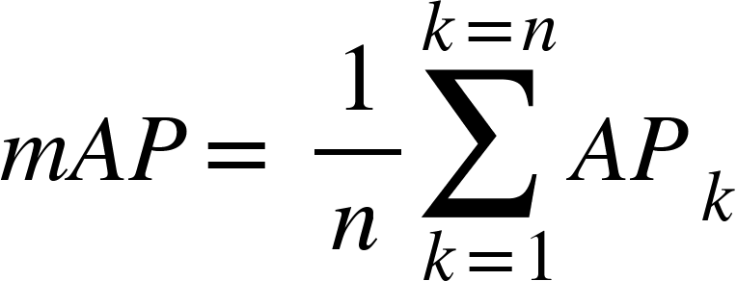
Model Training & Evaluation
The image dataset is divided into 3,500 images for training, 1,000 images for validation, and 500 images for testing.
To evaluate and compare the performance of DL models, three different tests are conducted.
The primary evaluation metric is mean Average Precision (mAP), which is frequently used in safety helmet detection studies to display trends in precision and recall for various models
Precision rate (Pr), recall rate (Re), and F1-score (F1) are further evaluation metrics.

Slide 12
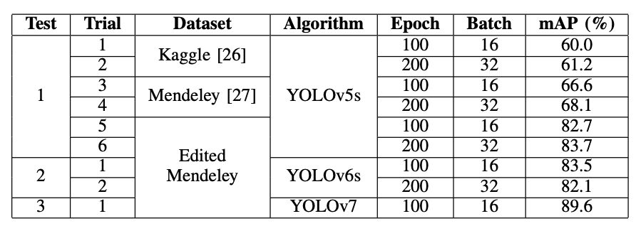
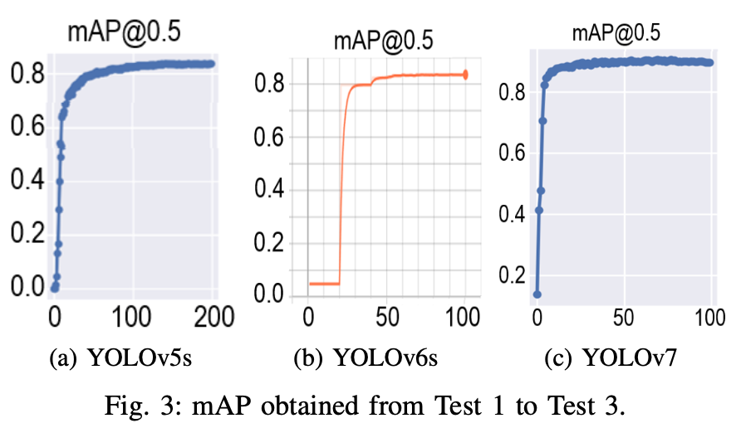
Results

Slide 13
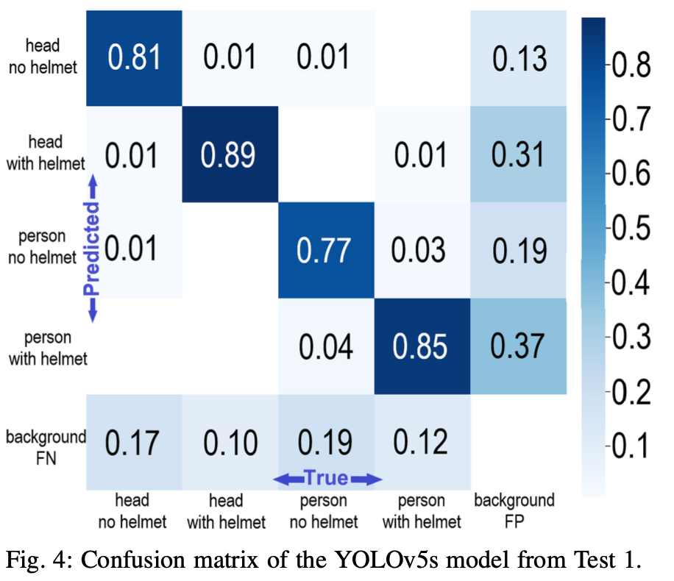
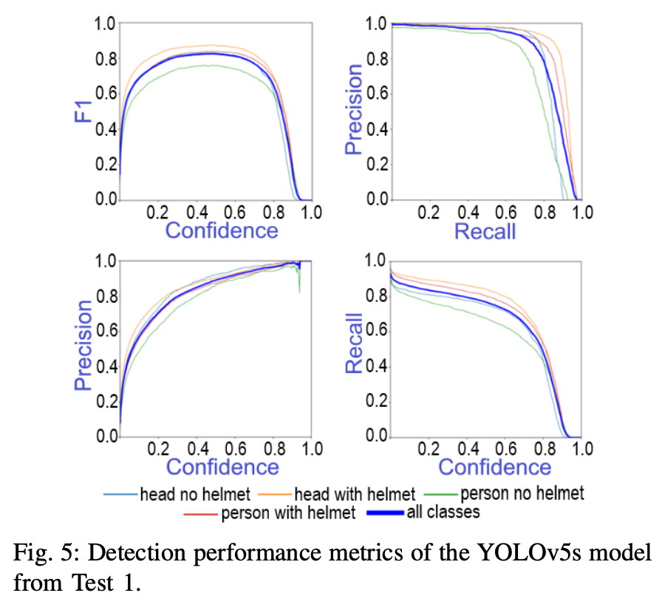
Results (YOLOv5s)

Slide 14
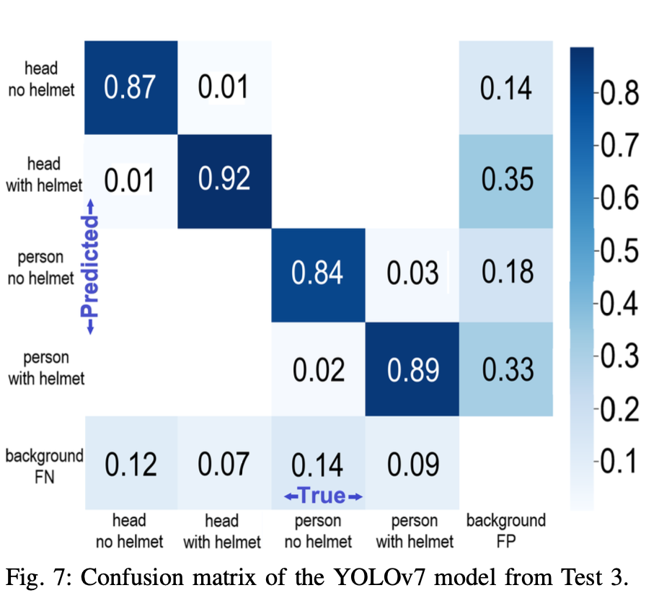
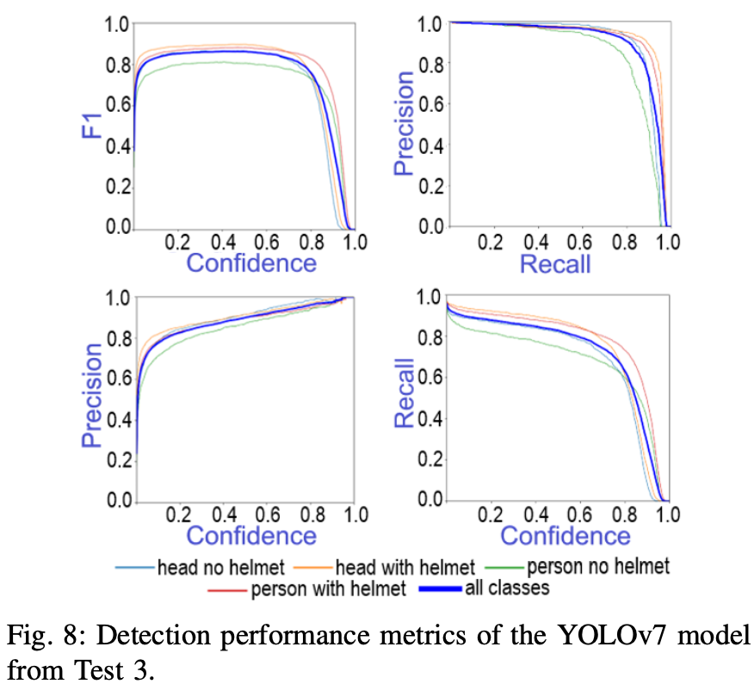
Results (YOLOv7s)

Slide 15
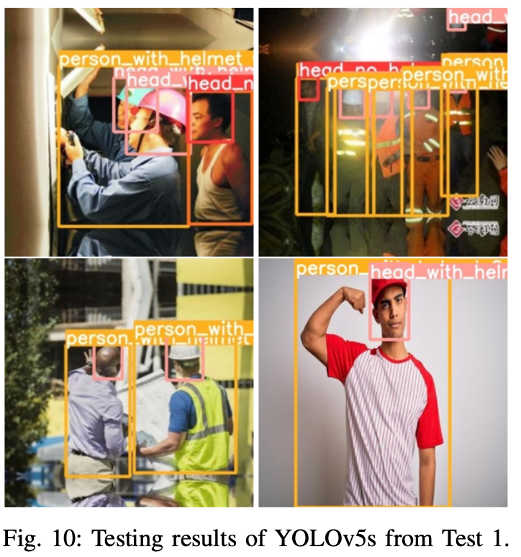
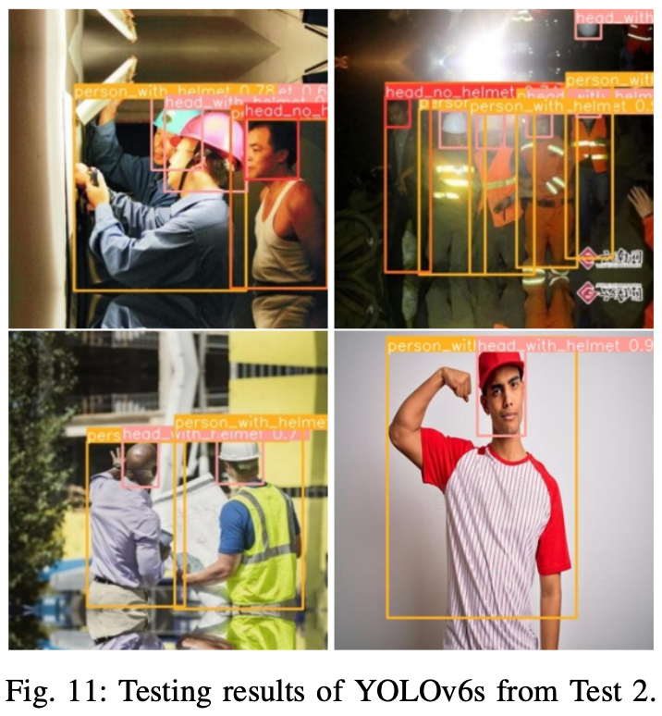
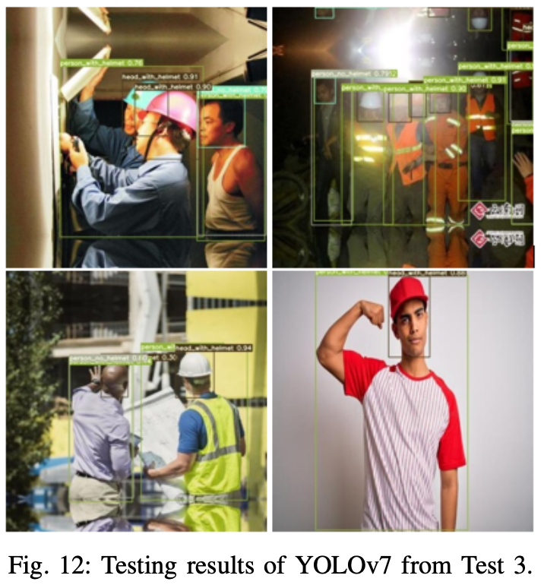
Results

Slide 16
Discussion
YOLO (You Only Look Once) models are specially designed for real-time object detection tasks. They offer several advantages like
Speed: YOLO models are one-stage detectors
Accuracy: YOLO models , automatically learn and extract meaningful features from raw image data.
Wide Range of Applications: YOLO models are versatile and can be applied in various domains, including security and surveillance, industrial automation, healthcare, and more
State-of-the-art Performance: YOLO models consistently achieve competitive performance on benchmark datasets.

Slide 17
Conclusion
The comparative study of Safety Helmet Detection using YOLOv5, YOLOv6, and YOLOv7 has provided valuable insights into the performance and capabilities of these state-of-the-art object detection models.
YOLOv7 emerged as the top performer, demonstrating exceptional accuracy and robustness in detecting safety helmets.
The choice of epoch value and batch size has a considerable impact on the results obtained for each DL model.
The quality and composition of the image dataset play a crucial role in determining the test results of the simulations.

Slide 18
Future Work
Fine-tuning and Optimization: Further fine-tuning of the YOLO models could be performed to improve their accuracy without compromising speed.
Improvements and modifications will be made to the training image dataset, YOLOv7 model, and training settings (e.g., epoch value, batch size) to further enhance the detection accuracy.
Further research is necessary to develop techniques that can distinguish between the safety helmets and regular caps.
Domain Adaptation: Adapting the models to specific industrial environments and fine-tuning them for domain-specific safety helmet detection tasks can enhance their practical applicability.
Real-world Deployment: Deploying the selected model in real-world settings and evaluating its performance in various industrial contexts will provide valuable feedback and insights for potential optimizations.

Slide 19


